Slide 1

Introduction To Python
Session 1-PART 1
Dr. Rakhee Chhibber

Slide 2
Agenda
Python
Features of Python
Flavors of Python
Execution of a Python Program
Python Virtual Machine (PVM)
Viewing the Byte Code
Frozen Binaries
Memory Management in Python
Comparisons between C and Python
Comparisons between Java and Python

Slide 3
What is Python?
Python is a high-level, interpreted, general-purpose programming language that emphasizes code readability and simplicity. It supports multiple programming paradigms, including:
  Procedural
  Object-Oriented
  Functional programming

Slide 4
Features of Python
🧠 1. Simple and Easy to Learn and Open Source
🔄 2. Interpreted Language - Code is executed line-by-line.
3. Extensive Standard Library - File I/O, OS interaction, Web services, Regular expressions, Data manipulation (math, statistics, JSON, etc.)
🔍 4. Dynamically Typed -No need to declare variable types.
🌍 5. Cross-Platform - runs on Windows, macOS, Linux, and even mobile and embedded devices.
🧰 6. Supports Multiple Programming Paradigms - Procedural Programming, Object-Oriented Programming, Functional Programming
📡 7. Huge Ecosystem of Libraries and Frameworks - For Web: Django, Flask For Data Science: Pandas, NumPy, Matplotlib, For Machine Learning: Scikit-learn, TensorFlow, PyTorch For Automation: Selenium, PyAutoGUI
🧹 8. Automatic Memory Management - Python has built-in garbage collection.
👨‍👩‍👧‍👦 9. Large Community and Active Development - Huge community support on Stack Overflow, GitHub, etc. And Thousands of open-source Python packages.
🔄 10. Integration Capabilities - Easily integrates with C, C++, Java, and other languages. Good for API development and system integration.

Slide 5
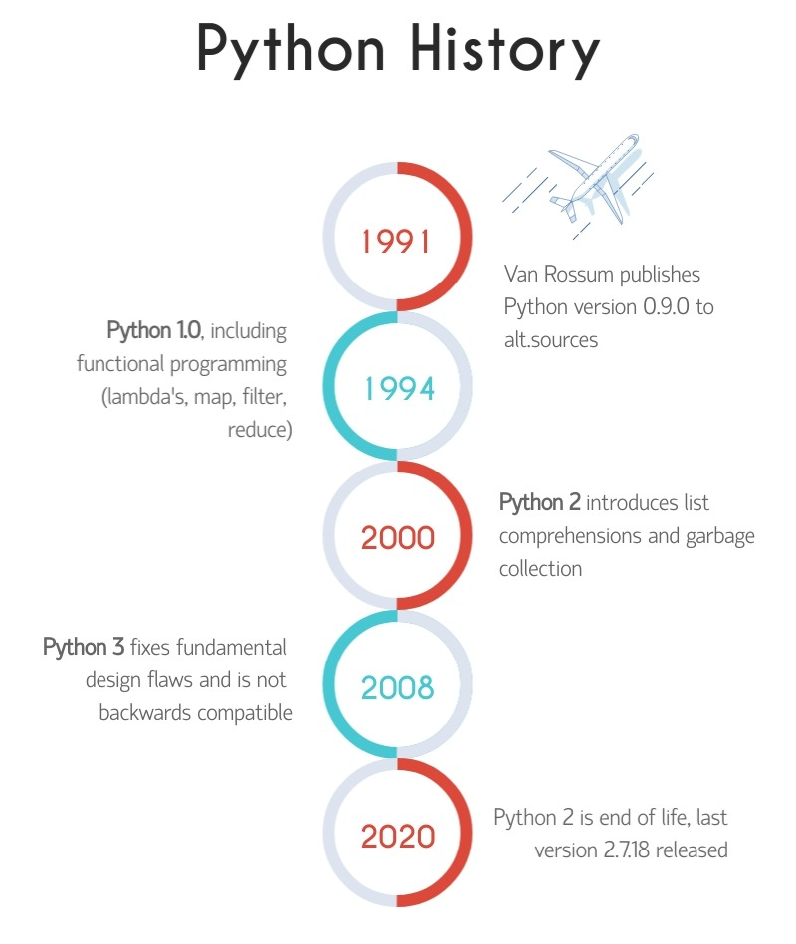
History of Python
Year | Event
1989 | Guido van Rossum starts working on Python
1991 | Python 0.9.0 is released
2000 | Python 2.0 is launched (with list comprehensions, garbage collection)
2008 | Python 3.0 released (not backward compatible)
Present - 2023 Python 3.12.x | Widely used in AI, ML, data science, automation, web development

Slide 6
Flavors of Python
Flavor | Based On | Target Platform | Use Case
CPython | C | General-purpose | Default, most widely used
Jython | Java | JVM | Integrate with Java apps
IronPython | C# | .NET CLR | Use in .NET environments
PyPy | Python | High performance | Speed-critical applications
Stackless | CPython | Concurrent environments | Games, microthreads
MicroPython | Python | Microcontrollers | IoT, hardware projects
Brython | JavaScript | Web browsers | Python in the browser

Slide 7
Python Program – Execution on Different Modes
✅ 1. Script Mode (Running .py files) | python my_script.py
✅ 2. Using an IDE (Integrated Development Environment) | PyCharm, VS Code, IDLE (comes with Python)
✅ 3. Using Jupyter Notebook | jupyter notebook
✅ 4. Using Online Interpreters | Google Colab, Programiz
✅ 5. Converting to Executables (Frozen Binaries)- pyinstaller, py2exe | For Ex- pyinstaller my_script.py
✅ 6. Embedded in Web Apps / APIs | Flask / Django for web FastAPI for REST APIs

Slide 8
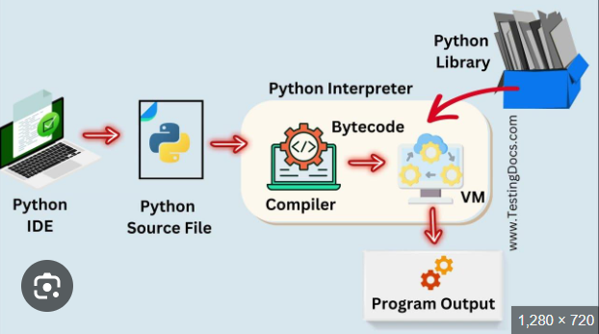
Python Virtual Machine

Slide 9
Execution of Python Program
+-----------------+
| .py Source Code |
+-----------------+
|
v
+---------------------+
| Compilation to .pyc |
+---------------------+
|
v
+-----------------------+
| Execution by Python VM|
+-----------------------+
|
v
+--------------+
| Program Output|
+--------------+

Slide 10
Viewing The Bytecode
import dis
def greet():
print("Hello")
dis.dis(greet)
Will provide the assembly code

Slide 11
Frozen Binaries
Frozen binaries are standalone executable files that bundle a Python application along with the Python interpreter and all dependencies into a single file or directory. This makes the application runnable without requiring Python to be installed on the target machine.
Purpose | Benefit
Distribute Python programs | No Python installation required on target
Simplify deployment | Easy to share via .exe, .app, etc.
Protect source code | Optionally hides the original .py files
Tool | Platform | Code
PyInstaller | Cross-platform | pip install pyinstaller pyinstaller --onefile my_script.py

Slide 12
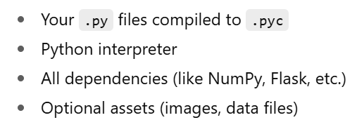
🔐 What's Included in a Frozen Binary?

Slide 13
⚠️ Limitations
Executables are larger in size (can be 20–100MB+)
May require tweaking for complex apps (e.g., GUI, web servers)
Platform-specific (Windows .exe won't run on Linux)

Slide 14
Memory Management in Python

Slide 15
Memory Allocation in Python
There are two parts of memory:
Stack Memory - contiguous blocks of memory. Its allocation happens in the function call stack and the size of memory to be allocated is known to the compiler and whenever a function is called, its variables get memory allocated on the stack.
Heap Memory - allocated during the execution of instructions written by programmers. It is called heap because it is a pile of memory space available to programmers to allocated and de-allocate. The variables which are needed outside of method or function calls or are shared within multiple functions globally are stored in Heap memory.

Slide 16
🧠 1. Stack Memory
(for function execution)
✅ What it stores:
Local variables inside functions
Function calls and their execution context
🔄 How it works:
LIFO (Last-In-First-Out) structure
When a function is called, a stack frame is created
When the function exits, the stack frame is popped (deleted)

Slide 17
def add(a, b):
result = a + b
return result
sum = add(2, 3)
Example
When add(2, 3) is called:
A stack frame is created with variables a, b, and result
Once add returns, this stack frame is removed

Slide 18
🗂️ 2. Heap Memory-(for object storage)
✅ What it stores:
All Python objects and data structures
  Lists, dictionaries, custom class objects
  Even values of variables (in some cases)
🧠 How it works:
Managed by the Python Memory Manager
Memory is allocated dynamically
Cleaned up by the Garbage Collector when no references are left

Slide 19
my_list = [1, 2, 3]
my_list (the reference) lives in stack memory
The actual list [1, 2, 3] lives in the heap
Example
my_list (the reference) lives in stack memory
The actual list [1, 2, 3] lives in the heap

Slide 20
Difference between Stack and Heap Memory
Feature | Stack Memory | Heap Memory
Used For | Function calls & local variables | Objects, data structures, dynamic data
Allocation | Static / During function call | Dynamic / During runtime
Access Speed | Fast | Slower
Lifetime | Until function exits | Until object is no longer referenced
Managed By | Python Call Stack | Python Memory Manager + Garbage Collector

Slide 21
Memory Management Components
1. Private Heap
2. Python Memory Manager
3. Raw Memory Allocator
4. Object-Specific Allocators
5. Garbage Collector (GC)
6. Reference Counting
7. Cyclic Garbage Collector

Slide 22
1. Private Heap - All Python objects and data structures are stored which is managed internally by Python and not accessible directly by the programmer.
2. Python Memory Manager - Controls the allocation and deallocation of memory in the private heap and Automatically assigns memory to variables and releases it when no longer needed. Works closely with the garbage collector.
3. Raw Memory Allocator - Interfaces directly with the Operating System. Reserves memory blocks in the private heap. It’s a low-level component ensuring enough space is available.

Slide 23
4. Object-Specific Allocators - Manage memory for specific object types (like lists, integers, dictionaries) and Optimize performance and memory reuse for frequently used types.
5. Garbage Collector (GC) - Detects and frees memory occupied by objects that are no longer in use. Uses techniques like reference counting and cyclic garbage collection.
6. Reference Counting - Each object maintains a count of references to it. When the reference count drops to zero, the memory is reclaimed.
7. Cyclic Garbage Collector - Handles reference cycles that reference counting alone can’t clean up. Runs periodically to find and collect cyclically linked unreferenced objects.

Slide 24
🧮 Comparison : Python vs C
Feature | 🐍 Python | 🛠️ C
Type | High-level, interpreted language | Low-level, compiled language
Speed | Slower due to interpretation | Very fast due to direct machine code
Memory Management | Automatic (Garbage Collection) | Manual (malloc/free)
Syntax | Easy, readable, beginner-friendly | Complex, requires more code
Compilation | No compilation needed (interpreted) | Requires compilation to run
Portability | Highly portable | Portable but dependent on hardware
Use Cases | Scripting, automation, AI, web dev | Embedded systems, OS/kernel dev, drivers
Pointers | Not supported | Fully supported
Standard Libraries | Very rich and extensive | Very minimal
Development Speed | Fast development | Slower due to manual coding

Slide 25
🧮 Comparison : Python vs Java
Feature | 🐍 Python | ☕ Java
Type | Interpreted, dynamically typed | Compiled to bytecode, statically typed
Execution | Line-by-line via interpreter | Bytecode run on JVM (Java Virtual Machine)
Syntax | Simple, concise | Verbose
Speed | Slower than Java in general | Faster due to JIT compilation
Memory Management | Automatic (Garbage Collection) | Automatic (Garbage Collection)
Error Handling | Dynamic (errors at runtime) | Compile-time error checks
Use Cases | AI, scripting, automation, web dev | Enterprise apps, Android, large-scale systems
Multithreading | Not true multi-threading (due to GIL) | True multithreading support
Mobile App Dev | Not commonly used | Primary language for Android development
Community and Libraries | Huge and growing | Mature and widely used

Slide 26
Installation and Writing Our First Python Program
Session 1 – PART 2

Slide 27

Installing Python for Windows
Testing the Installation in Windows 11
Installing pycharm
Setting the Path to Python
Writing Our First Python Program
Getting Python Documentation Help
Executing a Python Program
Getting Help in Python
Reopening the Python Program in IDLE
AGENDA

Slide 28
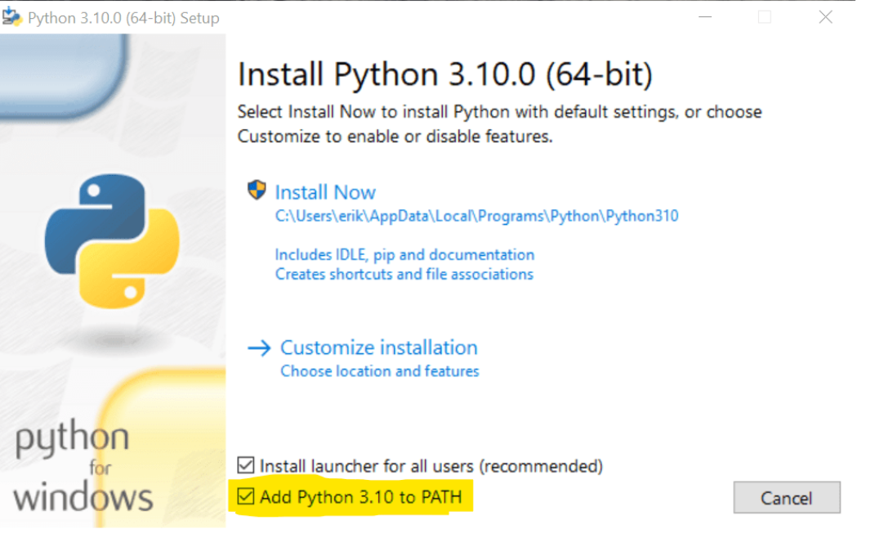
https://python.land/installing-python

Slide 29
https://www.jetbrains.com/pycharm/download/?section=windows
Installing pycharm
Select desired installation options:
Create Desktop Shortcut:
  Open Folder as Project: Right-click menu for opening folders in PyCharm.
Associate .py files: Opens Python files directly with PyCharm.
Add bin folder to PATH: (Requires a system restart) Allows you to run
PyCharm from the command line.

Slide 30
Check the python version
On terminal
Python –version
Google Colab / Jupyter Notebook
!python --version

Slide 31
Getting Help
Using the help() function:
  Interactive Help: Calling help(). To exit, type quit.
  Specific Object Help: It provides direct access to its documentation (docstrings). For example, help(print) or help(list).
Accessing Docstrings Directly: using the __doc__ attribute of an object. For example, print.__doc__ or my_function.__doc__.
  Community Forums and Websites: like Stack Overflow, Python-specific mailing lists, and subreddits (e.g., r/LearnPython
  Python Package Index (PyPI): 3rd party packages, PyPI is a valuable resource.
Debugging Tools: using a debugger (like pdb or integrated debuggers in IDEs)

Slide 32
Setting the Path to Python – on Windows
Locate Python Installation: Find the directory for python.exe file.
Edit the system environment variables –
C:\Python39.
C:\Python39\Scripts
Verify: On Command Prompt or PowerShell by
python --version

Slide 33
Setting the Path to Python – on MacOS or Linux
Locate Python Installation: Standard locations include /usr/local/bin
Edit Shell Configuration File: (e.g., .bashrc, .zshrc, or .profile) in a text editor. And add the file path replacing /path/to/python with your actual Python installation path:
export PATH="/path/to/python:$PATH“
Save file
Verify: Type python --version in the terminal to confirm Python is accessible.

Slide 34
Data Types
Session 1 – PART 3

Slide 35
Agenda
Python Syntax
Python Comments
Datatypes & Variables
Type Casting
Operators
Numbers
Booleans
Strings

Slide 36
Python Program Syntax
Indentation in Python
Python Variables
Python Identifiers
Python keywords

Slide 37
Python Comments
Single line - #
Multi-line comments - Triple quotes (either ''' or """)
Break statement into multiple lines - Using Backslashes(\) – for example
sentence = "This is a very long sentence that we want to " \
"split over multiple lines for better readability.“
# For mathematical operations
total = 1 + 2 + 3 + \
4 + 5 + 6 + \
7 + 8 + 9
print(total)

Slide 38
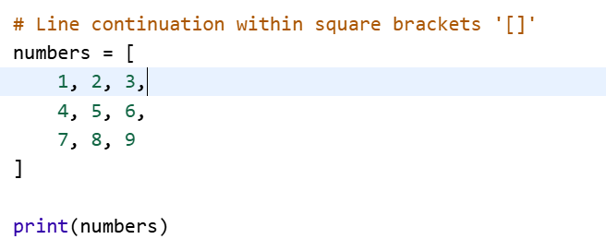
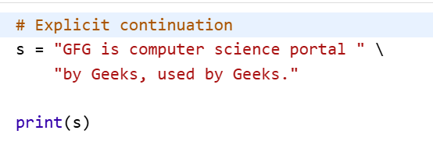
Continuation of Statements
Implicit Continuation – content between (), [], {}
Explicit Continuation

Slide 39
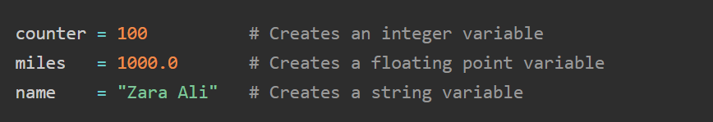

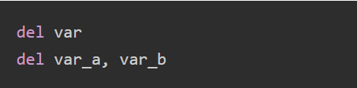
Data Types & Variables

Slide 40
- Getting Type of Variable – type()
- Typecasting
x=str(10)
v=int(10)
z=float(15.5)
Python is case sensitive [Age and age are different]
Multiple Assignment – a=b=c=10
type() – to display the class of an object
Id() – to display the id of that object

Slide 41
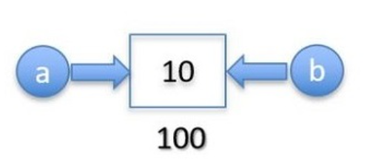
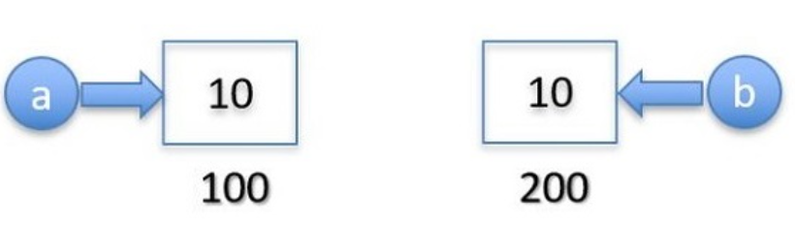
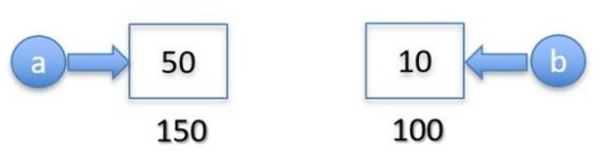
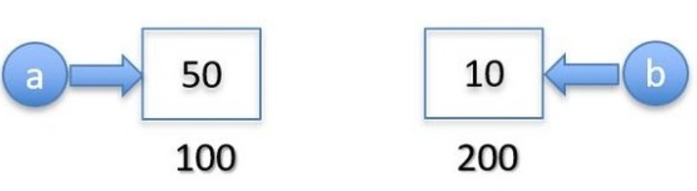
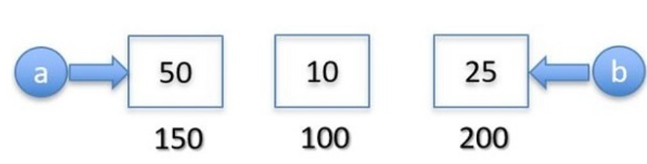
Python vs C/C++ Variables
Python Variables
C/C++ Variables
a=50
a=50
b=25

Slide 42
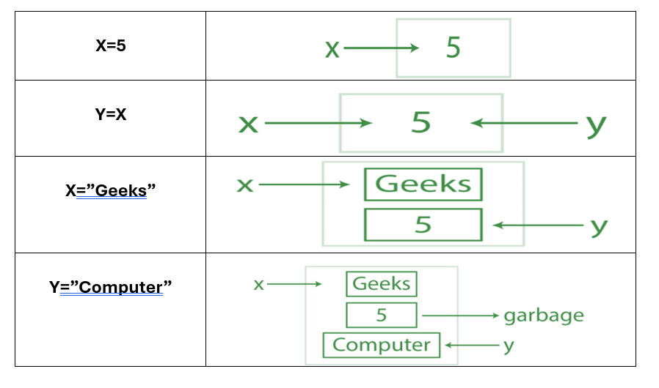
Object Reference in python

Slide 43
Operators
Arithmetic operators - +,-,*,/,%,**,//
Assignment operators - =,+=,-=, /=,*=,%=
Comparison operators - >,<,>=,<=,!=
Logical operators – and, or, not
Identity operators – is, is not
Membership operators – in, not in
Bitwise operators - <<, >> , ~

Slide 44
Python Numbers
int
float
complex

Slide 45
Python Boolean
print(10 > 9)
print(10 == 9)
print(10 < 9)

Slide 47
Thank you
Dr. Rakhee Chhibber
Rakhee.chhibber@hcltech.com

